Slide 1


Xccelerate.co
Data Science - Machine Learning

Slide 2


Introduction to Machine Learning
Machine learning is a field of computer science that focuses on creating algorithms that can learn and make predictions based on data. These algorithms are designed to automatically improve their performance over time as they are exposed to more data.
One of the key benefits of machine learning is its ability to automate complex decision-making processes. For example, machine learning algorithms can be used to analyze large volumes of medical data in order to identify patterns and make accurate diagnoses.
Notes:
https://forms.gle/jnob3YLb33f7Zxcw5 - Feedback form

Slide 3
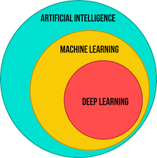
Notes:
https://forms.gle/jnob3YLb33f7Zxcw5 - Feedback form

Slide 4
Types of Machine Learning
There are three main types of machine learning: supervised learning, unsupervised learning, and reinforcement learning. Supervised learning involves training a model on labeled data, while unsupervised learning involves finding patterns in unlabeled data. Reinforcement learning involves training a model to make decisions based on feedback from its environment.
Each type of machine learning has its own strengths and weaknesses. Supervised learning is particularly useful for prediction tasks, while unsupervised learning is often used for clustering and anomaly detection. Reinforcement learning is well-suited for tasks that involve decision-making in complex environments.
Notes:
https://forms.gle/jnob3YLb33f7Zxcw5 - Feedback form

Slide 5
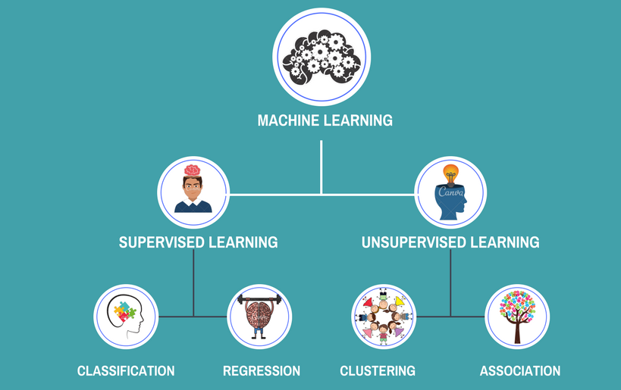
Source: https://www.intellspot.com/unsupervised-vs-supervised-learning/
Notes:
https://forms.gle/jnob3YLb33f7Zxcw5 - Feedback form

Slide 6
Recapping back
Supervised learning: In this type of learning, the algorithm is trained on labeled data, meaning that the data is already categorized or classified. The algorithm learns to make predictions or decisions based on the patterns it identifies in the labeled data.
Unsupervised learning: In this type of learning, the algorithm is trained on unlabeled data, meaning that the data is not categorized or classified. The algorithm learns to identify patterns and relationships in the data without any prior knowledge of what the data represents.
Reinforcement learning: In this type of learning, the algorithm learns by interacting with an environment and receiving feedback in the form of rewards or penalties. The algorithm learns to make decisions that maximize the reward it receives over time.
Notes:
https://forms.gle/jnob3YLb33f7Zxcw5 - Feedback form

Slide 7
Applications of machine learning:
Machine learning has a wide range of applications across industries, including healthcare, finance, and transportation. In healthcare, machine learning can be used to diagnose diseases, predict patient outcomes, and develop new treatments. In finance, machine learning can be used for fraud detection and risk management. In transportation, machine learning can be used to optimize routes and improve safety.
One of the most exciting applications of machine learning is in the field of autonomous vehicles. Machine learning algorithms can be used to analyze sensor data and make decisions about how to navigate the vehicle, making it possible for cars to drive themselves safely and efficiently.
Notes:
https://forms.gle/jnob3YLb33f7Zxcw5 - Feedback form

Slide 8
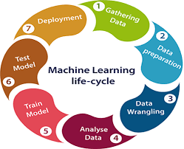
Notes:
https://forms.gle/jnob3YLb33f7Zxcw5 - Feedback form

Slide 9
Supervised learning is commonly used for tasks such as classification and regression. Classification involves predicting a categorical variable, such as whether an email is spam or not. Regression involves predicting a continuous variable, such as the price of a house based on its features.
Example, if we are trying to predict whether a patient has diabetes based on their age, weight, and blood sugar levels, the algorithm would learn how these features are related to the patient's diabetes status.
Notes:
https://forms.gle/jnob3YLb33f7Zxcw5 - Feedback form

Slide 10
Unsupervised learning is often used in exploratory data analysis, where the goal is to gain insights into the dataset without having any specific target variable or output in mind. It is also used in tasks such as anomaly detection, where the goal is to identify unusual or unexpected patterns in the data.
One of the main challenges with unsupervised learning is that it can be difficult to evaluate the performance of the algorithm, since there is no explicit target variable or output to compare against. Therefore, domain expertise and knowledge of the data are important when interpreting the results of an unsupervised learning algorithm
Notes:
https://forms.gle/jnob3YLb33f7Zxcw5 - Feedback form

Slide 11
Use case of unsupervised learning
Customer segmentation for businesses: Customer segmentation involves dividing a customer base into groups based on similar characteristics such as demographics, behavior, or preferences. By segmenting customers, businesses can tailor their marketing strategies to each group, which can lead to more effective campaigns and higher customer satisfaction.
Notes:
https://forms.gle/jnob3YLb33f7Zxcw5 - Feedback form

Slide 12
Use case of unsupervised learning
Another use case of unsupervised learning is in anomaly detection. Anomaly detection involves identifying unusual or unexpected patterns in the data that may indicate fraud, errors, or other unusual events. Anomaly detection can be used in many applications such as credit card fraud detection, intrusion detection, and predictive maintenance.
Notes:
https://forms.gle/jnob3YLb33f7Zxcw5 - Feedback form

Slide 13
Reinforcement learning is a type of machine learning in which an agent learns to make decisions by interacting with an environment and receiving rewards or penalties for its actions. The goal of the learning algorithm is to learn a policy, which is a set of rules that dictate what actions to take in each situation to maximize the cumulative reward.
One example of reinforcement learning is training an algorithm to play a game. Let's take the game of chess as an example.
As the algorithm plays more games, its policy would become more refined, and it would start to make better decisions. Eventually, the algorithm would become an expert player, able to defeat even the strongest human opponents.
Notes:
https://forms.gle/jnob3YLb33f7Zxcw5 - Feedback form

Slide 14
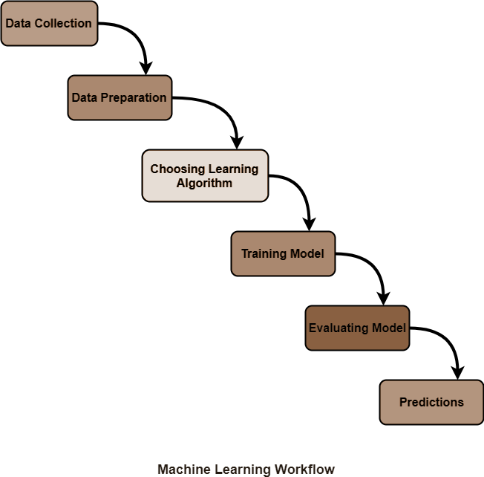
Machine learning workflow (Recap)
Notes:
https://forms.gle/jnob3YLb33f7Zxcw5 - Feedback form

Slide 15
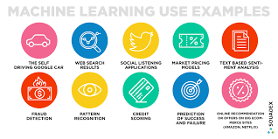
Notes:
https://forms.gle/jnob3YLb33f7Zxcw5 - Feedback form

Slide 16
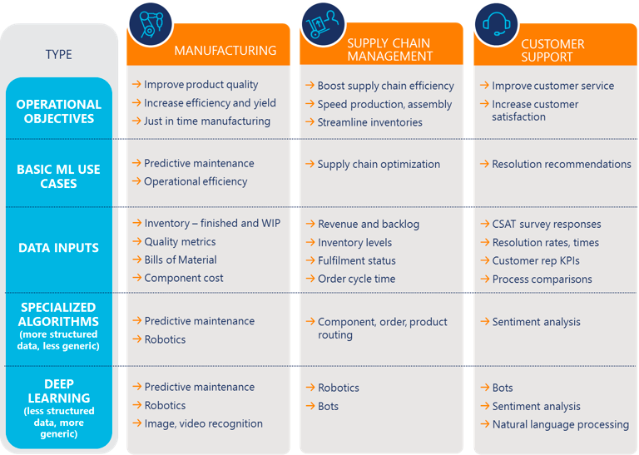
Notes:
https://forms.gle/jnob3YLb33f7Zxcw5 - Feedback form

Slide 17

Before we dive into the ML algorithms, we must first prepare our ML environment. We will code everything in Google Colab.
https://colab.research.google.com/
Please visit this link. Once we are on the page,
at the top right corner, we will log in. Once logged
in we can attach our google drive to colab and
Start working. We will go through all steps in the
next slide.
Notes:
https://forms.gle/jnob3YLb33f7Zxcw5 - Feedback form

Slide 18


After we login, we will see this page
3
2
Wait to get connected to a runtime environment
Click here to get the drive options
Cancel this overlay
1
Notes:
https://forms.gle/jnob3YLb33f7Zxcw5 - Feedback form

Slide 19


5
4
4
Click this button to get a cell containing some code. Press the play once you’re done.
Once done, we will see these in our window
Notes:
https://forms.gle/jnob3YLb33f7Zxcw5 - Feedback form

Slide 20

6
Connect and provide the necessary permissions
Notes:
https://forms.gle/jnob3YLb33f7Zxcw5 - Feedback form

Slide 21

6
Make sure your drive is visible, then click on file and new notebook
Notes:
https://forms.gle/jnob3YLb33f7Zxcw5 - Feedback form

Slide 22
Regression
Regression analysis is a form of predictive modelling technique which investigates the relationship between a dependent (target) and independent variable (s) (predictor). This technique is used for forecasting, time series modelling and finding the causal effect relationship between the variables.
Let’s go through one regression algorithm, but the following are some of the famous ones:
1. Linear Regression (We will go through this one)
2. Lasso Regression
3. Polynomial Regression
4. Stepwise Regression
5. Ridge Regression
Notes:
https://forms.gle/jnob3YLb33f7Zxcw5 - Feedback form

Slide 23
Linear Regression
Simple linear regression is a statistical method that enables users to summarise and study the relationships between two continuous (quantitative) variables. Linear regression is a linear model wherein a model that assumes a linear relationship between the input variables (x) and the single output variable (y). Here, y can be calculated from a linear combination of the input variables (x). When there is a single input variable (x), the method is called a simple linear regression. When there are multiple input variables, the procedure is referred to as multiple linear regression.
Notes:
https://forms.gle/jnob3YLb33f7Zxcw5 - Feedback form

Slide 24
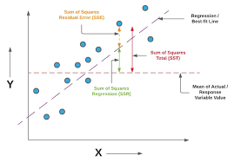
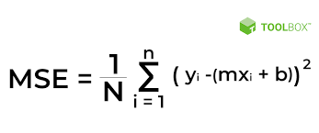
Regression Analysis Formula
f (Y) = mx + b
Notes:
https://forms.gle/jnob3YLb33f7Zxcw5 - Feedback form

Slide 25
Multiple Linear Regression
The difference between simple linear regression and multiple linear regression, multiple linear regression has (>1) independent variables, whereas simple linear regression has only 1 independent variable.
Simple Linear Regression → y = bo + b1*x1
Multiple Linear Regression → y = bo + b1*x1 + b2*x2 + .... + bn*xn
Where, y → Dependent variable
x1, x2, ....xn → Independent variables
Notes:
https://forms.gle/jnob3YLb33f7Zxcw5 - Feedback form

Slide 26
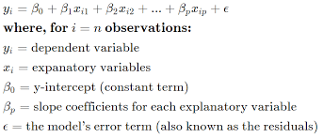
Multiple Regression Formula
∑Y= mx1 + mx2+ mx3+ b
Notes:
https://forms.gle/jnob3YLb33f7Zxcw5 - Feedback form

Slide 27
Regression Error Metrices
MAE, MSE, RMSE, MAPE etc.
• MSE (Mean Squared Error)
• RMSE (Root Mean Squared Error)
• MAE (Mean Absolute Error)
• MAPE (Mean Absolute Percentage
Error)
Notes:
https://forms.gle/jnob3YLb33f7Zxcw5 - Feedback form

Slide 28
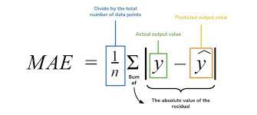
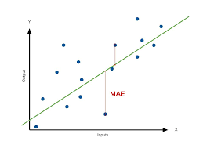
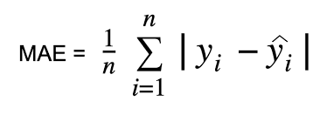
Mean Absolute Error
MAE: We just look at the absolute difference between data and model’s predictions
Lower MAE → Better model
Notes:
https://forms.gle/jnob3YLb33f7Zxcw5 - Feedback form

Slide 29
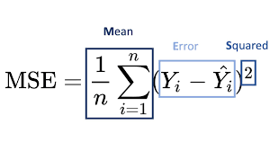
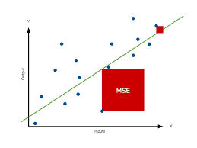
Mean Squared Error
MSE is going to be a huge number because of squaring, hence, we can’t compare it with MAE. This ultimately means that outliers in our data will contribute to much higher total error in the MSE than they would the MAE. Similarly, our model will be penalized more for making predictions that differ greatly from the corresponding actual value. This is to say that large differences between actual and predicted are punished more in MSE than in MAE.
Notes:
https://forms.gle/jnob3YLb33f7Zxcw5 - Feedback form

Slide 30
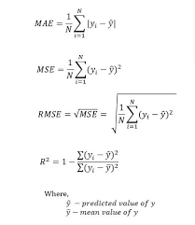
Root Mean Squared Error
RMSE = Square root(MSE)
As the name suggests, it is the square root of the MSE. Because the MSE is squared, its units do not match that of the original output. Researchers will often use RMSE to convert the error metric back into similar units, making interpretation easier. Since the MSE and RMSE both square the residual, they are similarly affected by outliers.
Notes:
https://forms.gle/jnob3YLb33f7Zxcw5 - Feedback form

Slide 31
Classification
Predicting category of new observations
Let’s go through one classification algorithms from below:
1. k-NN ( K- nearest neighbours) (This one)
2. Decision Trees
3. Random Forest
4. Naive Bayes
5. Support Vector Machines
6. Logistic Regression
Notes:
https://forms.gle/jnob3YLb33f7Zxcw5 - Feedback form

Slide 32
Introduction to KNN Classification
K-Nearest Neighbors (KNN) is a simple yet powerful classification algorithm used in machine learning. It is a non-parametric algorithm that makes predictions based on the closest data points in the feature space.
The KNN algorithm is widely used in various fields such as image recognition, natural language processing, and recommendation systems. It is easy to implement and can handle both binary and multi-class classification problems.
Notes:
https://forms.gle/jnob3YLb33f7Zxcw5 - Feedback form

Slide 33
Working of KNN Algorithm
The working of the KNN algorithm involves finding the K-nearest neighbors of a given data point in the feature space. The distance between the data points is calculated using various distance metrics such as Euclidean distance, Manhattan distance, etc.
Once the K-nearest neighbors are identified, the majority class among them is assigned to the given data point. This process is repeated for all the data points in the dataset to obtain the final classification results.
Notes:
https://forms.gle/jnob3YLb33f7Zxcw5 - Feedback form

Slide 34
Choosing the Value of K
The value of K is an important parameter in the KNN algorithm. A smaller value of K can lead to overfitting while a larger value of K can lead to underfitting. Therefore, it is important to choose an optimal value of K for the given dataset.
Various techniques such as cross-validation and grid search can be used to find the optimal value of K. Cross-validation involves dividing the dataset into training and validation sets and testing the algorithm on different values of K. Grid search involves testing the algorithm on a range of values of K and choosing the one with the highest accuracy.
Notes:
https://forms.gle/jnob3YLb33f7Zxcw5 - Feedback form

Slide 35
Advantages of KNN Algorithm
The KNN algorithm has several advantages such as its simplicity, easy implementation, and ability to handle both binary and multi-class classification problems.
It also does not make any assumptions about the underlying distribution of the data and can handle noisy data. Additionally, it can be used for both classification and regression tasks.
Disadvantages of KNN Algorithm
Despite its advantages, the KNN algorithm has some limitations. It is computationally expensive and requires high memory to store the entire dataset.
It also suffers from the curse of dimensionality where the performance of the algorithm decreases as the number of dimensions increases. Furthermore, it is sensitive to the choice of distance metric and the value of K.
Notes:
https://forms.gle/jnob3YLb33f7Zxcw5 - Feedback form

Slide 36
Unsupervised clustering
We will now look at one unsupervised model called K means clustering. K means clustering is a popular unsupervised machine learning algorithm used for partitioning data into distinct groups, or clusters. The algorithm works by iteratively assigning data points to the nearest cluster centroid, and recalculating the centroid based on the mean of all data points in the cluster.
One of the key advantages of k means clustering is its simplicity and speed. It can quickly identify natural groupings within large datasets, making it useful for a wide range of applications, from customer segmentation to image processing.
Notes:
https://forms.gle/jnob3YLb33f7Zxcw5 - Feedback form

Slide 37
Introduction to k means clustering
K means clustering is a popular unsupervised machine learning algorithm used for partitioning data into distinct groups, or clusters. The algorithm works by iteratively assigning data points to the nearest cluster centroid, and recalculating the centroid based on the mean of all data points in the cluster.
One of the key advantages of k means clustering is its simplicity and speed. It can quickly identify natural groupings within large datasets, making it useful for a wide range of applications, from customer segmentation to image processing.
Notes:
https://forms.gle/jnob3YLb33f7Zxcw5 - Feedback form

Slide 38
Choosing the optimal number of clusters
One of the most important decisions when using k means clustering is determining the optimal number of clusters. This can be done using methods such as the elbow method, which involves plotting the within-cluster sum of squares (WCSS) against the number of clusters, and selecting the point where the rate of decrease slows down.
It's important to note that the optimal number of clusters may vary depending on the dataset and the specific problem being solved. It's often necessary to experiment with different values to find the best solution.
Notes:
https://forms.gle/jnob3YLb33f7Zxcw5 - Feedback form

Slide 39
Applications of k means clustering
K means clustering has a wide range of applications across various industries and fields. In marketing, it can be used for customer segmentation and targeting. In biology, it can be used for gene expression analysis and protein structure prediction. In image processing, it can be used for object recognition and segmentation.
Other applications of k means clustering include anomaly detection, document clustering, and recommendation systems. Its versatility and speed make it a valuable tool for any data-driven organization.
Notes:
https://forms.gle/jnob3YLb33f7Zxcw5 - Feedback form

Slide 40
Limitations and extensions of k means clustering
While k means clustering is a powerful tool for identifying natural groupings within data, it has some limitations. For example, it assumes that clusters are spherical and equally sized, which may not always be the case in real-world datasets.
There are several extensions of k means clustering that address these limitations, such as hierarchical clustering, fuzzy clustering, and spectral clustering. These algorithms can handle more complex data structures and produce more accurate clustering results in certain scenarios.
Notes:
https://forms.gle/jnob3YLb33f7Zxcw5 - Feedback form

Slide 41
Next we look at EDA
Now that we know how to create a few ML algorithms, we look at exploratory data analysis or EDA. This is how we look at the data to try and answer questions related to the business. We try to leverage the data to see which features have the most information, what model we can apply, and which questions can and cannot be answered from our data.
Notes:
https://forms.gle/jnob3YLb33f7Zxcw5 - Feedback form

Slide 42
Exploratory data analysis
Data collection:
From customer records, server logs, surveys, interviews , crowdsourcing, web APIs, web scraping, publicly available datasets
Notes:
https://forms.gle/jnob3YLb33f7Zxcw5 - Feedback form

Slide 43
Exploratory data analysis
EDA deals with the process of performing initial investigations on data so as to discover patterns, spot, anomalies, test hypothesis and to check assumptions with the help of summary statistics and graphical representations
Notes:
https://forms.gle/jnob3YLb33f7Zxcw5 - Feedback form

Slide 44
Need for exploratory data analysis
To listen to data
To catch mistakes
To see patterns in the data
To find violations of statistical assumptions
Notes:
https://forms.gle/jnob3YLb33f7Zxcw5 - Feedback form

Slide 45
What are you trying to do in EDA?
What questions are you trying to solve or prove wrong?
What kind of data do you have and how do you treat different types?
What is missing from the data and how do you deal with it?
What are the outliers and why should you care about them?
How can you add change or remove features to get more out of your data ?
Notes:
https://forms.gle/jnob3YLb33f7Zxcw5 - Feedback form

Slide 46
So what should you do?
Examine all your variables, thoroughly and carefully before you begin the analysis.
Use visual displays whenever possible.
Transform each variable as necessary to deal with mistakes, outliers and distributions.
If you find a mistake fix it.
If you find an outlier, trim it or delete it or keep it if it is important .
If you are distributions are askew, transform the data.
Notes:
https://forms.gle/jnob3YLb33f7Zxcw5 - Feedback form

Slide 47
EDA using pandas or seaborn
For EDA, and as we will cover the following topics.
Variable identification.
Univariate analysis.
Bivariate analysis.
Notes:
https://forms.gle/jnob3YLb33f7Zxcw5 - Feedback form

Slide 48
Variable identification
Identify the type of variables that is what is this data type.
You also need to identify whether the data is
Qualitative-data are measurements that each fall into one of several categories.
Example-hair, colour, ethnic groups, and other attributes of population.
Quantitative-data are observations that a measure on a numerical scale.
Example-Distance travelled to college, number of children’s in a family.
Notes:
https://forms.gle/jnob3YLb33f7Zxcw5 - Feedback form

Slide 49
Qualitative data can be separated into to sub group:.
Discrete-if it is the result of counting like the number of students of a given ethnic group in a class or the number of books in a shelf
Continuous-if it is a result of measuring distance travelled or weight of the luggage.
Notes:
https://forms.gle/jnob3YLb33f7Zxcw5 - Feedback form

Slide 50
Univariate analysis
Univariate analysis deals with exploring variables individually. This also depends on the type of the variable.
Continuous variables -find the central tendency and spread of the data for the variable. Visualisation techniques, such as histograms and box plots would work well for this.
Categorical variables-frequency tables can be used to understand distribution of each variable. Visualisation techniques, such as bar plot or pie chart would work well for this.
Notes:
https://forms.gle/jnob3YLb33f7Zxcw5 - Feedback form

Slide 51
Bivariate Analysis
Bivariate analysis deals with exploring relationships between two variables. Different techniques are used depending on the types of variables being explored.
Both continuous variables-visualisation techniques, such as scatter plots would work well for this.
Both categorical variables-visualisation techniques, such as two-way tables, or stacked column charts .
Categorical and continuous variable-visualisation techniques, such as box plots for each level of categorical variables.
Notes:
https://forms.gle/jnob3YLb33f7Zxcw5 - Feedback form

Slide 52
Missing values
Identifying missing values - you can use the pandas data frames following functions to achieve this.
pandas.Dataframe.isna
Notes:
https://forms.gle/jnob3YLb33f7Zxcw5 - Feedback form

Slide 53
To take care of missing values
Remove rows with missing values.
Remove the entire column with missing values.
Set the values to meaningful value like zero mean median.
You can use the pandas data frames functions to achieve this.
pandas.Dataframe.dropna
pandas.Dataframe.drop
pandas.Dataframe.fillna
Imputation of missing values
Notes:
https://forms.gle/jnob3YLb33f7Zxcw5 - Feedback form

Slide 54
Feature Scaling
Standardise
Standard Gaussian distribution with a mean of 0 and standard deviation of 1
Modules: StandardScalar (from scikit learn)
Notes:
https://forms.gle/jnob3YLb33f7Zxcw5 - Feedback form

Slide 55
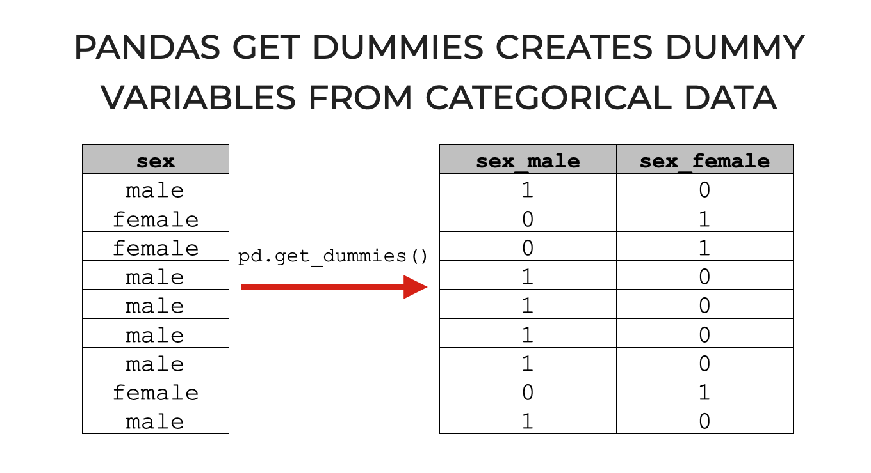
Handling Text and Categorical Data
Pandas get_dummies
Notes:
https://forms.gle/jnob3YLb33f7Zxcw5 - Feedback form

